Slide 1
Deep dive into the secrets of Temporal Tables
Configuration & Usage of Temporal Tables in SQL Server

Slide 2

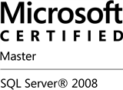


Uwe Ricken db Berater GmbH
I am working with IT-systems since early 1990's and with the main focus on Microsoft SQL Server since version 6.0. I started with development of database applications in 1998 with a professional CRM-System based on Microsoft products (Microsoft Office and Microsoft SQL Server).
Since 2008 I'm focused exclusively on Microsoft SQL Server and working in 3rd level support teams for banks, insurances and global industries.
Since May 2013 I am a Microsoft Certified Master: SQL Server 2008 which was an amazing way into the depth of Microsoft SQL Server.
In July 2013 I have been awarded with the MVP Award for Microsoft SQL Server.
www: http://www.db-berater.de
email: uwe.ricken@db-berater.de
blog: http://www.sqlmaster.de
BlueSky: @sqlbambi

Slide 3
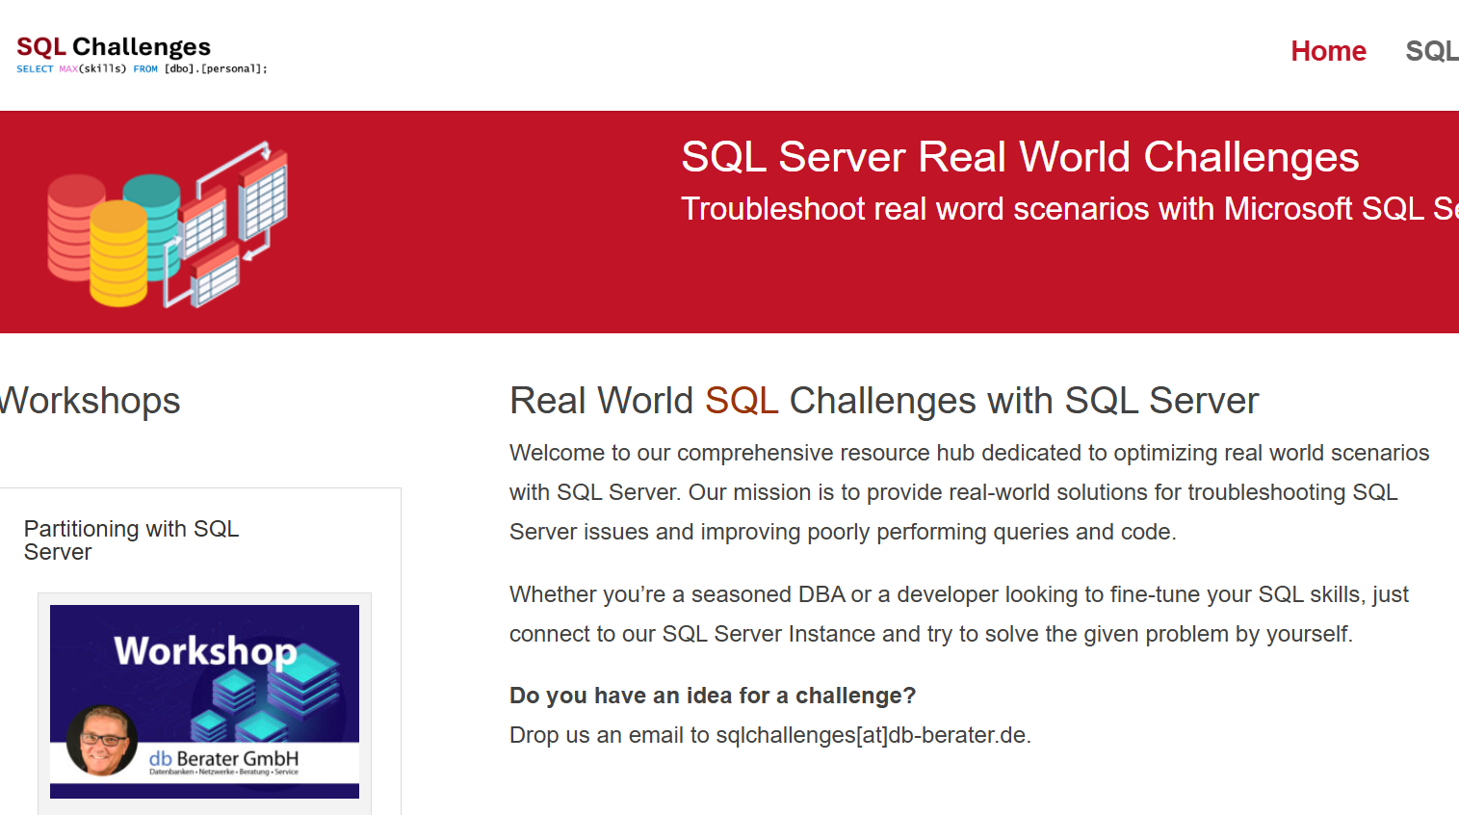
Challenge SQL Server real world scenarios
Get a challenge at least once a month
Connect to a provided SQL Server Instance
Load the challenge scenario
Try to solve it
Blog about your solution
Leave a link in the comments of the challenge to your blog post.
https://sqlchallenges.de

Slide 4
What is a Temporal Table?
“Temporal Table” is a feature since SQL Server 2016.
It keeps a full history of data changes and allows point in time analysis.
A Temporal Table contains a reference to another table with a mirrored schema.
The system uses this table to automatically store the previous version of the row.

Slide 5
Operational area of Temporal Tables?
Analysis of data in relation to historical data from the business
Forensic auditing
Reconstruction of data of a dedicated table to any point in time
Calculation of trends over a predefined time period

Slide 6
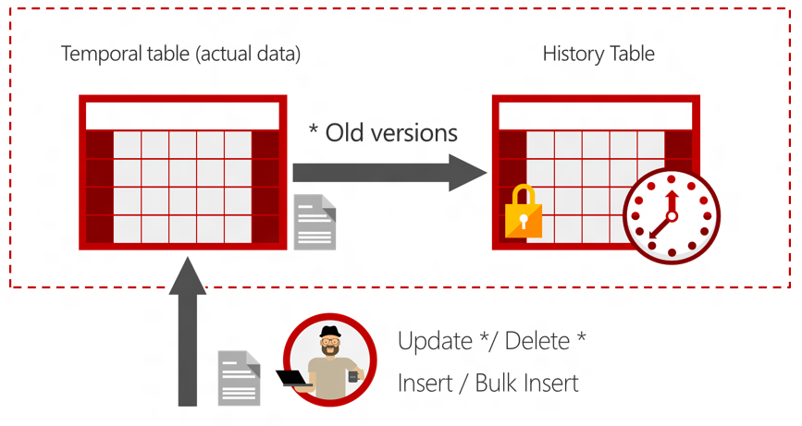
How do Temporal Tables work?
System Versioning for a table will be implemented as a pair of tables!
Two additional attributes with the data type datetime2 are used for the temporal validation of a record.
These attributes can be marked as HIDDEN.
https://msdn.microsoft.com/en-us/library/dn935015.aspx

Slide 7
Requirements/Constraints for Temporal Tables
Requirements
PRIMARY KEY-Constraint is required!
the history table must have the same meta data!
History Table must not have constraints (PK, FK, DEFAULTS, …)
Constraints
TRUNCATE TABLE is not allowed for Temporal Tables!
Direct manipulation of data in the History Table is not possible!
DELETE and UPDATE CASCADE is not allowed, when the table is the detail in a Foreign Key relation!
INSTEAD_OF Trigger cannot be used!
FILETABLE cannot be used

Slide 8
Creating a Temporal Table
Temporal Tables can be created by three different ways:
anonymous History Table
definition of a name for the History Table.
PREVIOUSLY defined and implemented History Table
Option 1 and Option 2 will use Data Compression for the clustered index by default

Slide 9

Creating a Temporal Table
CREATE TABLE dbo.Department
(
DeptID int NOT NULL PRIMARY KEY CLUSTERED,
DeptName varchar(50) NOT NULL,
ManagerID INT NULL,
ParentDeptID int NULL,
SysStartTime datetime2 GENERATED ALWAYS AS ROW START NOT NULL,
SysEndTime datetime2 GENERATED ALWAYS AS ROW END NOT NULL,
PERIOD FOR SYSTEM_TIME (SysStartTime, SysEndTime)
)
WITH (SYSTEM_VERSIONING = ON (HISTORY_TABLE = history.Department));

Slide 10
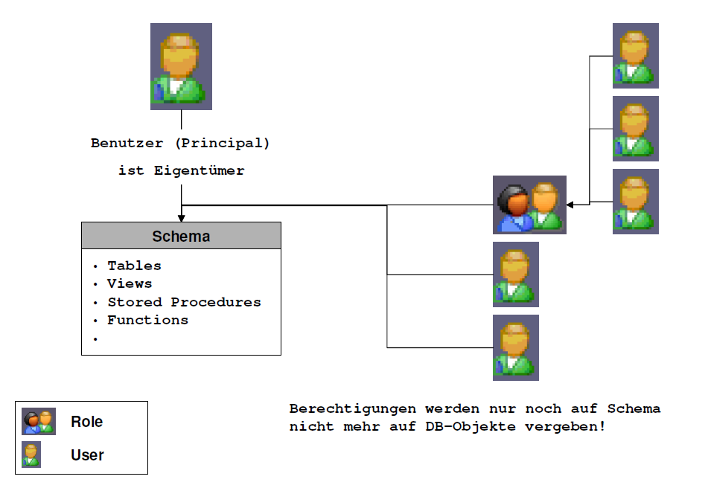
Best Practice for Architecture for Temporal Tables
demo_db
Drive F:
Drive S:
Filegroup
Filegroup HISTORY
Schema
Customer
Invoices
History
Customer
Invoices
Data_Reader

Slide 11
Update from a History Table
UPDATE can be used, to restore data by a predefined point of time!
UPDATE dbo.department
SET d.dept_name = history. dept_name
FROM dbo.department
FOR SYSTEM_TIME AS OF '2016-11-22T09:00:00' AS history
WHERE history.dept_id = 10
AND dbo.department.dept_id = 10;

Slide 12
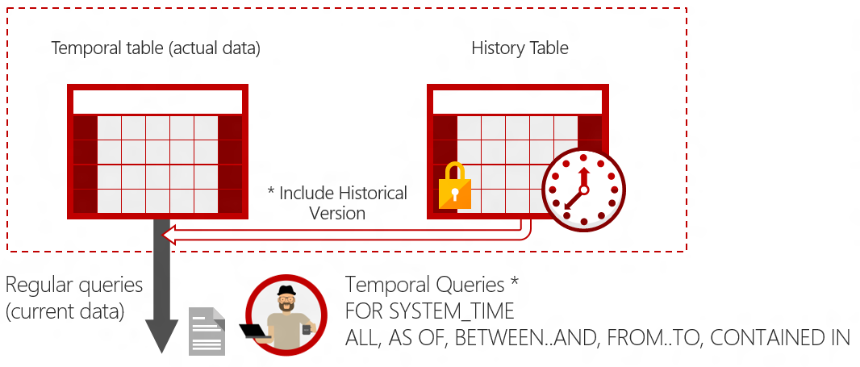
Querying Temporal Tables
https://msdn.microsoft.com/en-us/library/dn935015.aspx

Slide 13
Temporal Queries
CREATE TABLE ( PERIOD FOR SYSTEM_TIME ); ALTER TABLE ADD PERIOD FOR SYSTEM_TIME;
INSERT
UPDATE
DELETE
MERGE
SELECT * FROM TABLE WHERE ... ORDER BY;
SELECT * FROM TABLE FOR SYSTEM_TIME ... WHERE ORDER BY;
DDL
DML
QUERYING
TEMPORAL QUERYING

Slide 14
Querying Temporal Tables
Expression | Qualifying Rows | Description
AS OF <date_time> | SysStartTime <= date_time AND SysEndTime > date_time | Returns a table with rows containing the values that were actual (current) at the specified point in time in the past.
FROM … TO … | SysStartTime < end_date_time AND SysEndTime > start_date_time | Returns a table with the values for all row versions that were active within the specified time range, regardless of whether they started being active before the <start_date_time> parameter value for the FROM argument or ceased being active after the <end_date_time> parameter value for the TO argument.
BETWEEN … TO … | SysStartTime <= end_date_time AND SysEndTime => start_date_time | Same as above in the FOR SYSTEM_TIME FROM <start_date_time>TO <end_date_time> description, except the table of rows returned includes rows that became active on the upper boundary defined by the <end_date_time> endpoint.
CONTAINED IN (…) | SysStartTime >= start_date_time AND SysEndTime <= end_date_time | Returns a table with the values for all row versions that were opened and closed within the specified time range defined by the two datetime values for the CONTAINED IN argument.
ALL | All rows | Returns the union of rows that belong to the current and the history table.

Slide 15
What can go wrong, will go wrong
Captain Edward A. Murphy
Murphy’s Law

Slide 16
Agenda
NULLable Attributes (Constraints!)
Metadata operations
Adding/Dropping Columns in Tables
Changing Data Types in Tables
Renaming Columns or Tables
Nightmare with Triggers
New Security Features
Dynamic Data Masking
Row Level Security
Calculated Attributes
Long Running Transactions

Slide 17
NULL-able Attributes (Constraints!)
Changing of constraint NULL to NOT NULL
NULL becomes NOT NULL in an empty table
NULL becomes NOT NULL in a filled table
NOT NULL becomes NULL in a filled table

Slide 18
Metadata Operations
Adding new columns
New columns with (NOT) NULL-able properties
Behavior of DEFAULT-Constraints in System Versioned Temporal Tables
Delete existing column
Changing Data Types
Changing data types with fixed lengths
Changing data types with variable length
Renaming objects
Renaming columns in “System Versioned Temporal Table”
Renaming columns in “History Table”
Renaming columns when “System Versioned Temporal Table” is deactivated

Slide 19
Nightmare with Triggers
Triggers create duplicate record in History Table!
Instead of Trigger are not allowed in System Versioned-Temporal Tables!
A workaround to use INSTEAD_OF triggers is to cover the table in a view and apply an INSTEAD_OF trigger to this view!

Slide 20
Long Running Transactions
System Versioned Temporal Table can be problematic if long running transactions with heavy workload are used.
System Versioned Temporal Tables use the TRANSACTION BEGIN TIME as reference for the history data!
UPDATE row FROM dbo.customers;
UPDATE row FROM dbo.Customers
T1 (BEGIN)
T2 (BEGIN)
T2 (COMMIT)
T1 (COMMIT)

Slide 21
Dynamic Data Masking
A central data masking policy acts directly on sensitive fields in the database by full masking partial masking of data.
Privileged users or roles that do have access to the sensitive data.
Simple Transact-SQL commands define and manage masks
Dynamic Data Masking does not encrypt the data. Data can be ascertain by Brute-Force attacks!

Slide 22
Row Level Security
System Versioned Temporal Tables are compatible with Row Level Security.
Row-Level Security enables customers to control access to rows in a database table based on the characteristics of the user executing a query (e.g., group membership or execution context).
Every Table which requires RLS need to have a dedicated security predicate.

Slide 23
Calculated Attributes
System Versioned Temporal Table can use calculated columns.
As long as System Versioned Temporal Table is implemented, it is not allowed to add calculated columns to the table.
The History Table MUST store the data in a persisted columns!
ALWAYS think about the rule that the meta data in the history table must be the same as in the System Versioned Temporal Table!

Slide 24
variable PRIMARY KEYS
A PRIMARY KEY is required for using System Versioned Temporal Tables
A variable PK may lead to information loss when the data will be queried by the syntax for System Versioned Temporal Tables
Make sure you don’t allow changing values for the PK!

Slide 25
Permissions for Temporal Tables
Activation and deactivation of SYSTEM_VERSIONING requires CONTROL-permissions for the actual table as for the History Table.
When SYSTEM_VERSIONING is set to ON, no data in History Table can be changed.
Querying data in History Tabelle requires SELECT-permission

